Slide 1
Media Access Control (MAC)
15.09.2021

Slide 2
Data Link Control Layer (DLC)
The main role of the DLC layer is to establish reliable point to point or point to multi-point connection between different devices over wired or wireless medium.
The DLC layer is subdivided into two sub-layers:
The logical link control (LLC)
The medium access control (MAC)
Medium Access Control comprises all mechanisms that regulate user access to a medium

Slide 3
Media Access Control (MAC)
The medium is shared between the stations.
When a station sends data, another station may attempt to do so at the same time.
The data from the two stations collide and become corrupted (garbled).
It is the protocol that controls access to the physical transmission medium on a LAN.

Slide 4
Media Access Control (MAC)
When nodes or stations are connected and use a common link, called a multipoint or broadcast link
need a multiple-access protocol to coordinate access to the link
Media access control (MAC) is a sublayer of the data link layer (DLL)
Multiple access protocols are required to decrease collision and avoid crosstalk

Slide 5
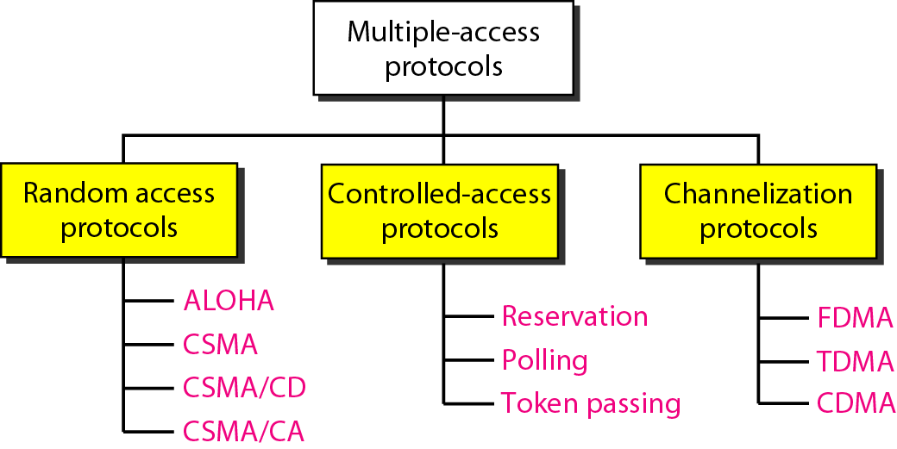
Figure 12.2 Taxonomy of multiple-access protocols discussed in this chapter
For wireless not included with us

Slide 6
RANDOM ACCESS
All stations have same superiority that is no station has more priority than another station.
Any station can send data depending on medium’s state( idle or busy).
It has two features:
There is no fixed time for sending data
no scheduled time for a station to transmit.
Transmission is random among the stations.
That is why these methods are called random access.
There is no fixed sequence of stations sending data
no rules specify which station should send next.
Stations compete with one another to access the medium.
That is why these methods are also called contention methods.

Slide 7
collision
if more than one station tries to send, there is an access conflict—collision—and the frames will be either destroyed or modified.

Slide 8
To avoid access conflict or to resolve it when it happens, each station follows a procedure
❑ When can the station access the medium?
❑ What can the station do if the medium is busy?
❑ How can the station determine the success or failure of the transmission?
❑ What can the station do if there is an access conflict?

Slide 9
ALOHA
Developed at the University of Hawaii in early 1970.
It was designed for a radio (wireless) LAN, but it can be used on any shared medium.
Pure Aloha & Slotted Aloha

Slide 10
Pure Aloha/slotted aloha
Pure ALOHA and Slotted ALOHA both are the Random Access Protocols
Pure ALOHA - each station sends a frame whenever it has a frame to send.
does not require Slots.
only one channel to share, there is the possibility of collision between frames from different stations.
Each station can access at any time
Slotted ALOHA station cannot send data in continuous time manner. It divides the time in slot.
All senders have to be synchronized
It do not allow the user whenever they have data.

Slide 11
Pure Aloha - Protocol Description
When a station sends data it waits for an acknowledgement.
If the acknowledgement doesn’t come within the allotted time then the station waits for a random amount of time called back-off time (Tb) and re-sends the data.
Since different stations wait for different amount of time, the probability of further collision decreases.

Slide 12
ALOHA Protocols
Pure ALOHA Protocol Description
Stations transmit at equal transmission time (all stations produce frames with equal frame lengths).
A station that has data can transmit at any time
After transmitting a frame, the sender waits for an acknowledgment for an amount of time (time out) equal to the

Slide 13
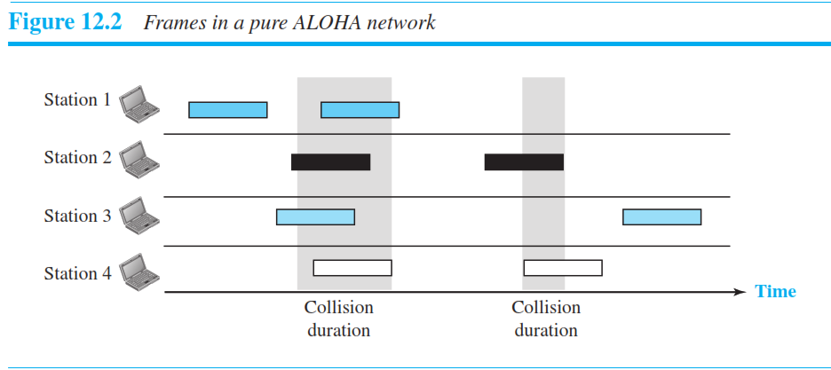
There are a total of eight frames on the shared medium.

Slide 14
Round-trip propagation delay
each station waits a random amount of time before resending its frame - the backoff time T_{B}
maximum number of retransmission attempts-K_{max}
Maximum propagation delay(T_{prop}): time it takes for a bit of a frame to travel between the two separated stations.

Slide 15
maximum round-trip propagation delay = 2* t_{prop}
If no ACK was received, sender assumes that the frame or ACK has been destroyed and resends that frame after it waits for a random amount of time
If station fails to receive an ACK after repeated transmissions
round-trip propagation delay = 2* Frame transmission time (T_{p})
twice the amount of time required to send a frame between

Slide 16
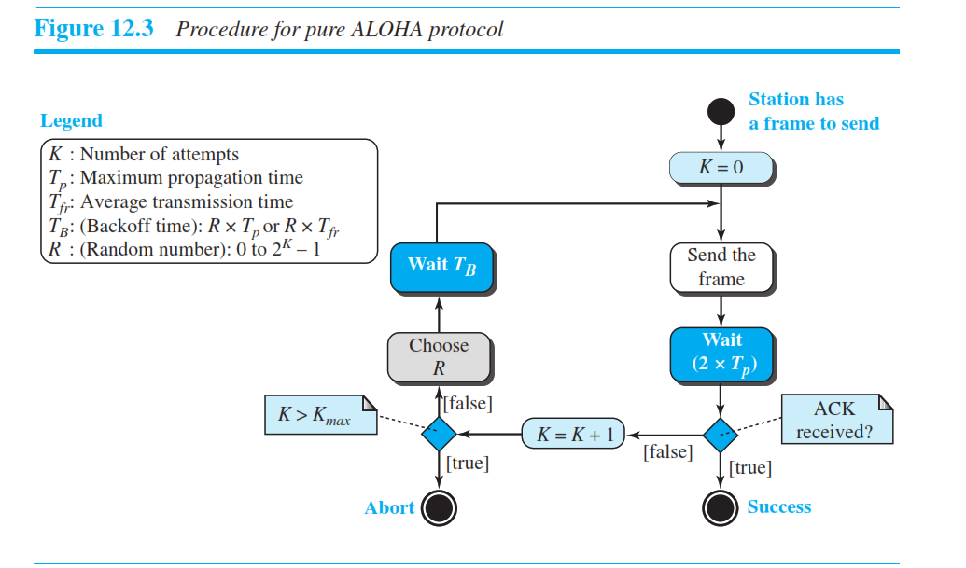

Slide 17
Slotted Aloha
It is similar to pure aloha, except that we divide time into slots and sending of data is allowed only at the beginning of these slots.
If a station misses out the allowed time, it must wait for the next slot. This reduces the probability of collision.

Slide 18
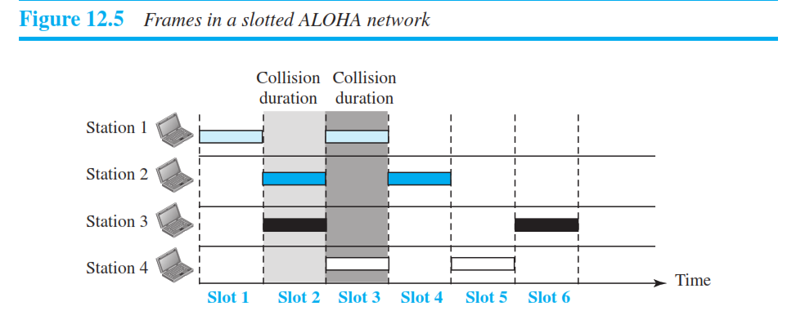
In slotted ALOHA - divide the time into slots of T_{fr} seconds and force the station to send only at the beginning of the time slot

Slide 19
CSMA – Carrier Sense Multiple Access
each station first listen / sense to the medium (or check the state of the medium) for idle or busy before transmitting data.
If it is idle then it sends data, otherwise it waits till the channel becomes idle.
However there is still chance of collision in CSMA due to propagation delay.

Slide 20
For example
if station A wants to send data, it will first sense the medium.
If it finds the channel idle, it will start sending data.
However, by the time the first bit of data is transmitted (delayed due to propagation delay) from station A, if station B requests to send data and senses the medium it will also find it idle and will also send data.
This will result in collision of data from station A and B.

Slide 21
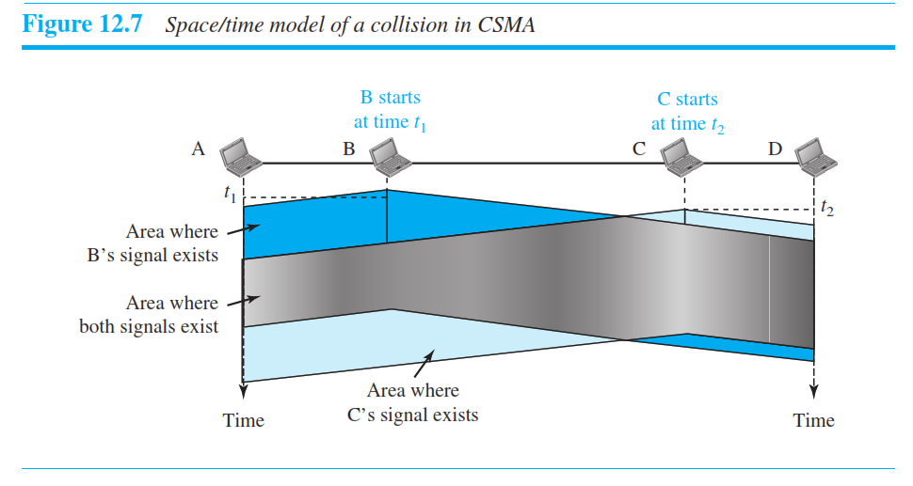
At time t1, station B senses the medium and finds it idle, so it sends a frame.
At time t2 (t2 > t1), station C senses the medium and finds it idle because, at this time, the first bits from station B have not reached station C.
Station C also sends a frame. The two signals collide and both frames are destroyed.

Slide 22
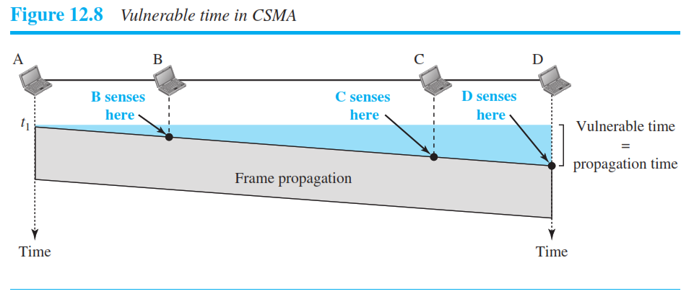

Slide 23
CSMA
What should a station do if the channel is busy? What should a station do if the channel is idle?
Three methods
1-persistent method,
Non persistent method, and
p-persistent method.

Slide 24
1-persistent:
The node senses the channel, if idle it sends the data,
otherwise it continuously keeps on checking the medium for being idle and transmits unconditionally (with 1 probability) as soon as the channel gets idle.

Slide 25
Non-Persistent:
The node senses the channel, if idle it sends the data, otherwise it checks the medium after a random amount of time (not continuously) and transmits when found idle.

Slide 26
P-persistent:
The node senses the medium, if idle it sends the data with p probability.
If the data is not transmitted ((1-p) probability) then it waits for some time and checks the medium again,
now if it is found idle then it send with p probability.
This repeat continues until the frame is sent.
It is used in Wifi and packet radio systems.

Slide 27
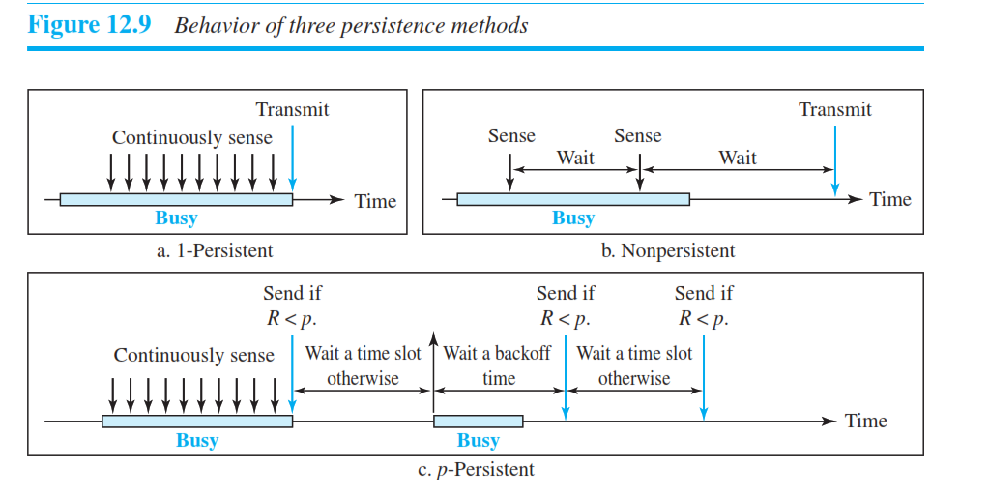

Slide 28
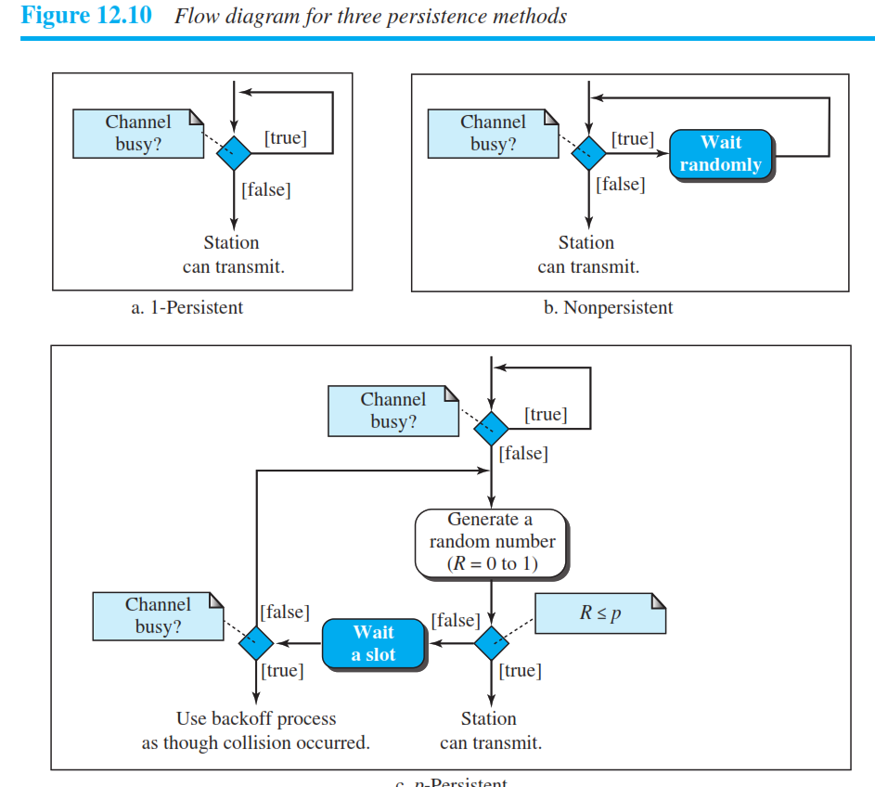

Slide 29
Carrier sense multiple access with collision detection(CSMA/CD)
Stations can terminate transmission of data if collision is detected.
a station monitors the medium after it sends a frame to see if the transmission was successful.
If so, the station is finished. If, however, there is a collision, the frame is sent again.

Slide 30
CSMA/CD - Minimum Frame Size
For CSMA/CD to work, we need a restriction on the frame size.
Before sending the last bit of the frame, the sending station must detect a collision, if any, and abort the transmission.
once the entire frame is sent, does not keep a copy of the frame and does not monitor the line for collision detection.

Slide 31
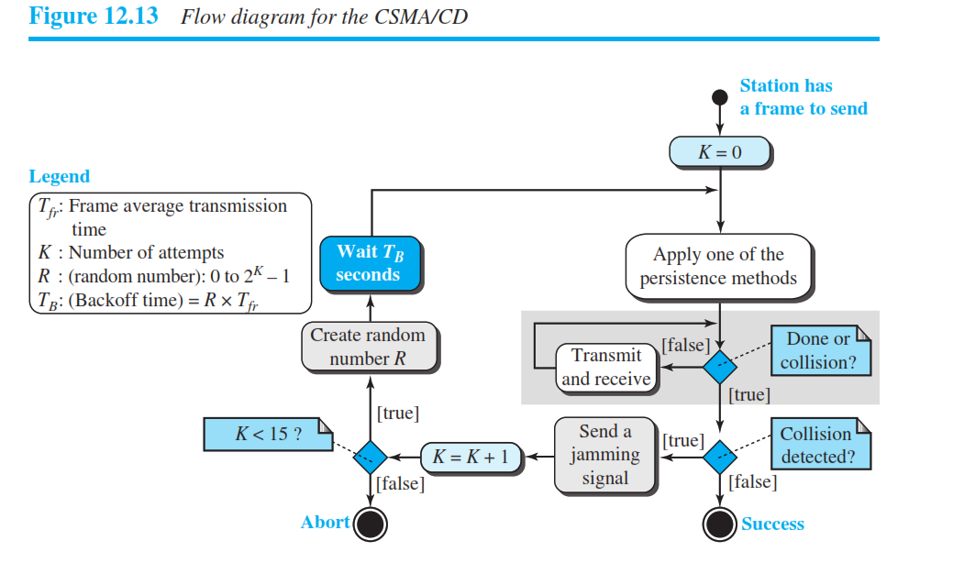

Slide 32
Carrier sense multiple access with collision avoidance (CSMA/CA)
Used for wireless networks.
Three strategies:
the interframe space (IFS),
the contention window, and
acknowledgments,

Slide 33
Interframe space
Station waits for medium to become idle and if found idle it does not immediately send data (to avoid collision due to propagation delay) rather it waits for a period of time called Interframe space or IFS.
After this time it again checks the medium for being idle.
The IFS duration depends on the priority of station.

Slide 34
Contention Window
It is the amount of time divided into slots.
If the sender is ready to send data, it chooses a random number of slots as wait time which doubles every time medium is not found idle.
If the medium is found busy it does not restart the entire process, rather it restarts the timer when the channel is found idle again.

Slide 35
Acknowledgement
The sender re-transmits the data if acknowledgement is not received before time-out.

Slide 36
CONTROLLED ACCESS
the stations consult one another to find which station has the right to send.
A station cannot send unless it has been authorized by other stations.

Slide 37
Reservation
a station needs to make a reservation before sending data.
Time is divided into intervals.
In each interval, a reservation frame precedes the data frames sent in that interval.
If there are N stations in the system, there are exactly N reservation minislots in the reservation frame.
Each minislot belongs to a station.
When a station needs to send a data frame, it makes a reservation in its own minislot.
The stations that have made reservations can send their data frames after the reservation frame.

Slide 38
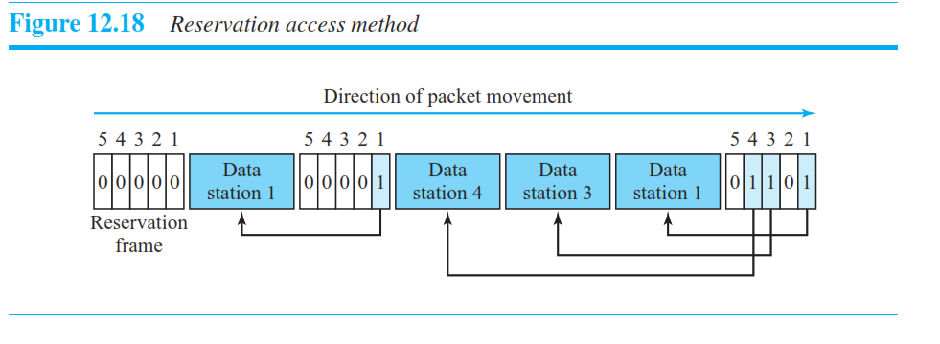

Slide 39
Polling
It works with topologies in which one device is designated as a primary station and the other devices are secondary stations.
The primary device controls the link;
the secondary devices follow its instructions.
It is up to the primary device to determine which device is allowed to use the channel at a given time.

Slide 40
Polling
uses poll and select functions to prevent collisions.
the drawback is if the primary station fails, the system goes down.

Slide 41
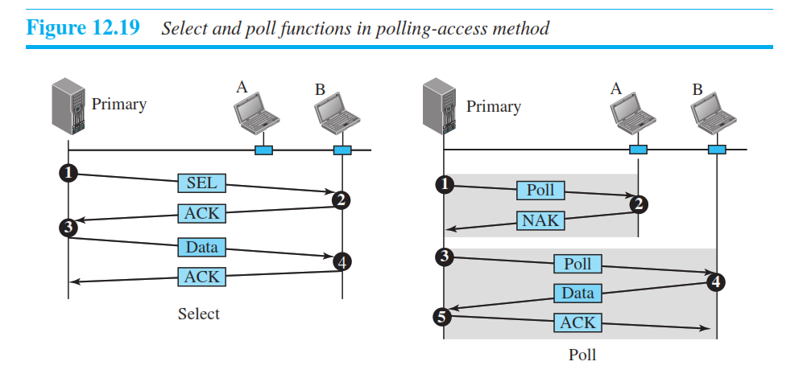

Slide 42
Token Passing
a special packet called a token circulates through the ring.
the token gives the station the right to access the channel and send its data.
When a station has some data to send, it waits until it receives the token from its predecessor.
for each station, there is a predecessor and a successor.
The predecessor is the station which is logically before the station in The ring;
the successor is the station which is after the station in the ring.

Slide 43
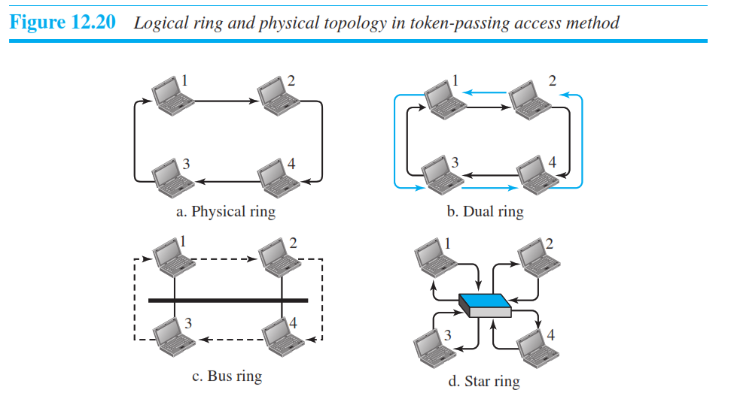
the stations in a network are organized in a logical ring
four different physical topologies that can create a logical ring.

